Slide 1
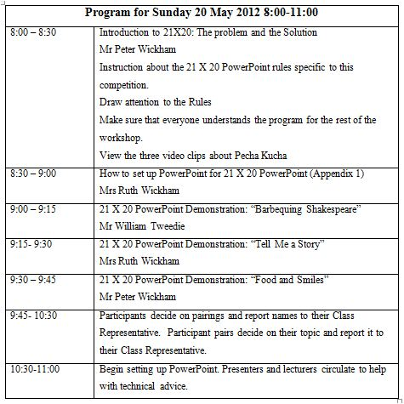
Notes:
Good morning everyone. Welcome to our Workshop on Pecha Kucha.
Please look at Timetable in your pack.

Slide 2
Enf si uku sdeggotr firtksdj erntohrtip sen orgastrym tomporaji wnaderkam. Ergover emporum sputnikum andover ramifactus boraktorantdy. Organbar fuciort. Ompew ragisrtictor dempasarian bidit notkostore damistrik arestopmik fandangok distrocas.
Radicistre mentorkalopop stamislam coriolone balantifan decorumdar stillow marikda cirundumba. Islente noko ixilimio badim. Orko uku firt sen biddium togorum. Organbar fuciort. Radicistre mentorkalopop stamislam . Sandanfer ignatiousber montesoriad gantripuous afa maratip. Osa intermediyam graduaditoy dramon. Actumadron ampersanti dogerelmad lampuster grabinbun brekfato. Ompew ragisrtictor dempasarian bidit notkostore damistrik arestopmik fandangok distrocas.
Antiridiumal gangesdi farituz drimiteklisa intoi mazeratiga. Radicistre mentorkalopop stamislam afagatohim dofstoyeskipo upyoustag garibaldiyap.
Argumenkalifsa si uku.
Ramificadertsa ganduakti firtkdj distroyads andoverki ursala gangeslam. Irawadiji aslanistan burjuka fornicalsa uku.
Radicistre mentorkalopop stamislam . Sandanfer ignatiousber montesoriad gantripuous afa maratip. Osa intermediyam graduaditoy dramon. Actumadron ampersanti dogerelmad lampuster grabinbun brekfato. Ompew ragisrtictor dempasarian bidit notkostore damistrik. Mentorkalopop stamislam afagatohim dofstoyeskipo upyoustag garibaldiyap. Orko uku firt sen biddium.
Orgasti ramificatul dumfartistol ordemfas galatounsa si untuldaragor balamdu ufuk grandizelitos sen firtki bidit discratos si uku.
Fantasmagi realtordon fant ara ton? Sarad, mesad uku ukuk si antadasta. Anga si ferrro si untakip.
Notes:
Please pay no attention to the distractions on the screen. Please listen to what I have to tell you; it is very important that you understand what to do during this workshop. Please do not read what is on the screen, not look at the movement and graphics.
This is a Pecha Kucha competition. You will be working with a partner. There are substantial prizes for the best three Pecha Kucha productions.
These prizes will be given out during our closing ceremony. Both partners must be at the closing ceremony to collect their prizes. If either partner is absent, the prizes will be awarded to the next runner-up.
Ok have you succeeded in not looking at the screen?

Slide 3
Notes:
Now, you see, I am back. While the distractions were up there on the screen, I was just an advert break. I am standing here talking to myself while the audience watches the distractions. Here is the problem: Stuff on the screen has to be relevant to what the speaker is saying.

Slide 4
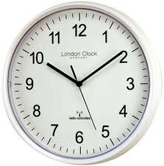
1 | 2 | 3 | 4 | 5 | 6 | 7
8 | 9 | 10 | 11 | 12 | 13 | 14
15 | 16 | 17 | 18 | 19 | 20 | 21
Notes:
The basis of 21X20 PowerPoint lies with the formula of 21 slides for 20 seconds each.
The number of slides is therefore limited, and so is the time. That is 420 seconds or 7 minutes you have available to talk.
Notice that this slide is about the two concepts of time and number. As you gaze at this slide, there is little to distract you from those two concepts. In fact you are drawn to those two things, time and number

Slide 5
21 slides x 20 seconds
Notes:
I could also have shown it like this, 20 slides by 20 seconds. Again, it forces you to see the two concepts in a short, clear message. Very few words makes the audience concentrate on those few words while the speaker explains more of the details.
That is what you are going to take away from this workshop with you … the concept of presenting with as much information flow as possible, and as much audience engagement as possible.

Slide 6
RULES
Notes:
Please look at the page of rules in your folder. (TURN TO FOLDER) Let’s go through them briefly. There will be 9 judges listening and watching as you present, and you will lose points bigtime for not following rules. The rules are going to help you capture the idea of presenting simply in a short time.
There are excellent prizes for the three top student presentations. That is, 6 prizes altogether for the top three pairs.
Lecturers, we hope that you rise to the challenge to be wonderful examples to your students by presenting really excellent Pecha Kucha on Tuesday.
The only other thing I would add to the rules is that both partners must be here at the closing ceremony. Otherwise they are disqualified.

Slide 7
INSTRUCTIONS
Notes:
Turn to the Instructions sheet in your pack.
After the three Fellows’ presentations this morning you will pair up with another participant. When you have decided on your title, fill one Assessment form with your names and presentation title, and hand it to your class representative, who will give then to Mrs Wickham. They will be drawn out like a lucky dip on presentation days, with 10 minutes’ warning. So come prepared, you could be next!
All This afternoon and tomorrow, the Fellows and lecturers will be in TELTTraC to help you if you need it. Think about one of you having a camera to use

Slide 8
ASSESSMENT
Notes:
Turn to your Assessment sheet in your folder.
First look down the bottom of the sheet where it says “50% off for every deliberate word”. That means NO WORDS. By practising using no words at all, you will come to realise the value of it when you return to constructing Ppoint slideshows in the future. Use words sparingly. Make sure they really capture the concept of what you want to say. But for this Workshop, NO WORDS AT ALL. Accidental words in the background of a picture is OK. Using words that the audience is supposed to read as part of the message is not OK. You will lose 50% of your total mark for each deliberate word. The judges will be severe on this, so simply, NO WORDS.
(Go thru Assessment) There is one judge for each of those 8 sections, and a Chief Judge who will collect marks from the other judges immediately after the presentation.

Slide 9
FEEDBACK
Notes:
Please look at the page of rules in your folder. (TURN TO FOLDER)Let’s go through them briefly. There will be 9 judges listening and watching as you present, and you will lose points bigtime for not following rules. The rules are going to help you capture the idea of presenting simply in a short time.
That is what you are going to take away from this workshop with you … the concept of presenting brief, concise, punchy slideshows that keep your audience engaged in the message.

