Slide 1
Tell me a story
By Ruth Wickham
Notes:
Title slide (no comment)

Slide 2
Notes:
This young lady with the absolutely charming smile is Sofea.
Sofea is 12 years old, and she is a year six student at the teaching school.
Sofea says that she is not good at cooking, but she is good at sleeping, even though – like most kids – she doesn’t like staying alone at night.
Sofea is a real person, but our story is a fiction.

Slide 3
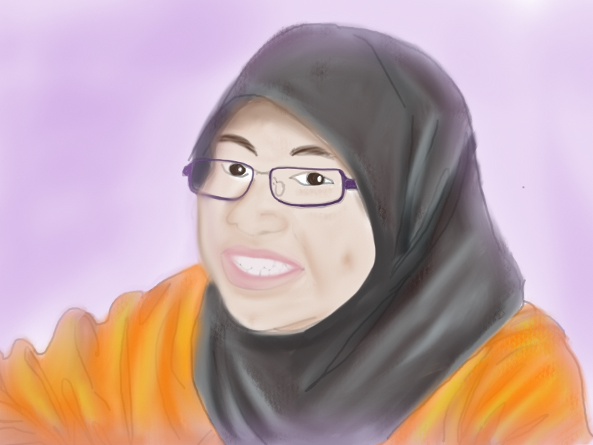
Notes:
Here is Sofea as a storybook character.
I have drawn some pictures to illustrate my story about Sofea and her friends.
To start with, this is a picture I drew of Sofea, just like the photo we just saw.
The story-book Sofea is very much like the real Sofea.

Slide 4
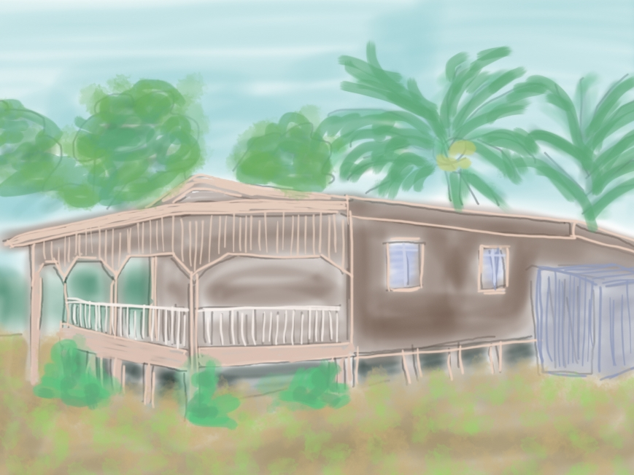
Notes:
Sofea lives in a village house. Her family house is old, and made of wood like many Malaysian village houses. The house is up on stilts which keeps it out of the water if there is a flood. It is a comfortable home, but the bathroom is outside away from the house, and the dark space under the house is probably full of insects and ghosts.

Slide 5
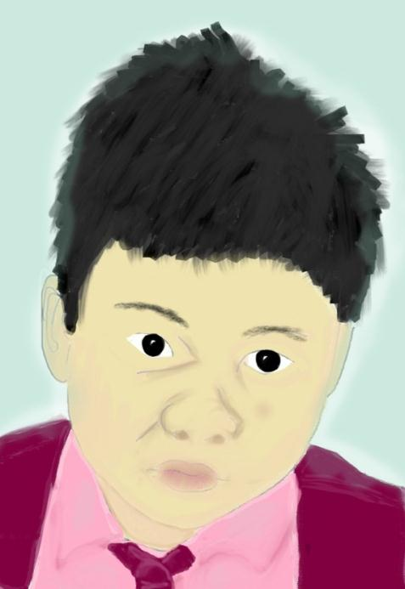
Notes:
This is Amir, he is also 12 years old and he is in the same class as Sofea.
Amir is good at football, and he likes to play goalie because he is good at jumping but not so fast at running.
He is also very good at science and scored the highest mark last year. Obviously he is a very clever boy.

Slide 6
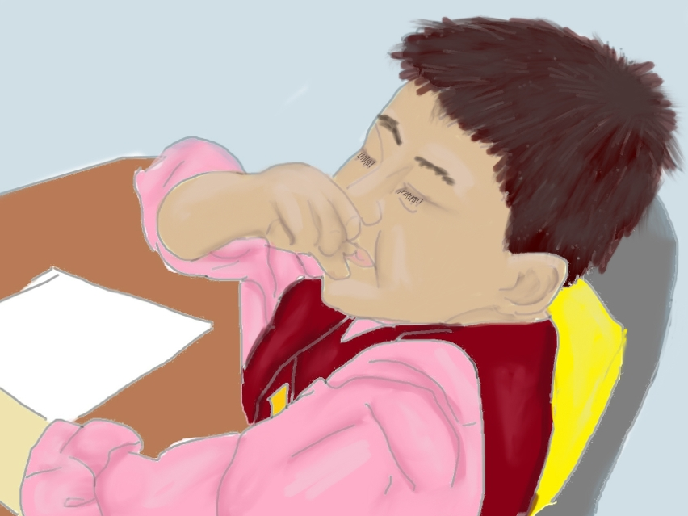
Notes:
Amir has a great sense of humour. He is always making jokes in the classroom.
Sofea and her friends on the girls’ side of the classroom enjoy the way he makes classes more fun. Of course, none of them can go and talk to him, because girls talk with girls and boys talk with boys.
He lives in a house in the village near to Sofea’s house.

Slide 7
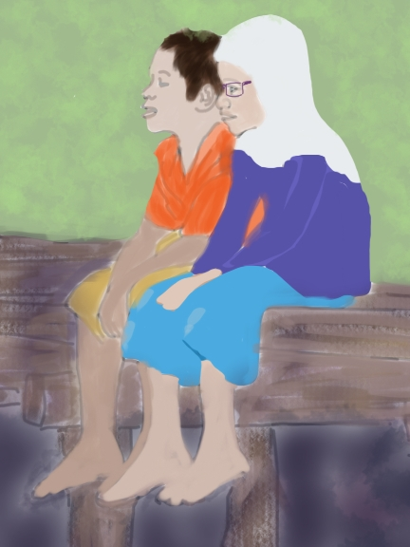
Notes:
Sometimes on weekends and in the holidays when there is not much to do, Sofea and Amir sit on the verandah and talk. He always seems to know stuff and has such funny and interesting things to say that Sofea sometimes wishes he was her brother or cousin.
And even though he is a boy, he also hates being alone in the dark at night.

Slide 8
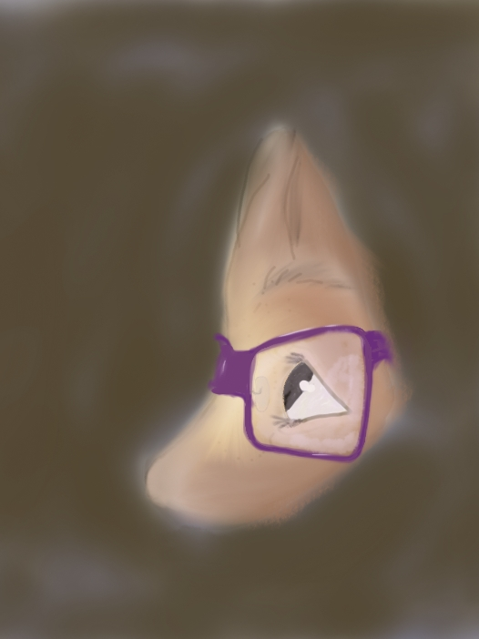
Notes:
One night the worst thing happened. Sofea had to go outside to the toilet. It was totally dark, but she could just see the light from the back door shining through a hole in the toilet door. Suddenly she had a creepy feeling that there was someone or something else nearby.
She waited very quietly and listened, watching through the hole in the door.

Slide 9
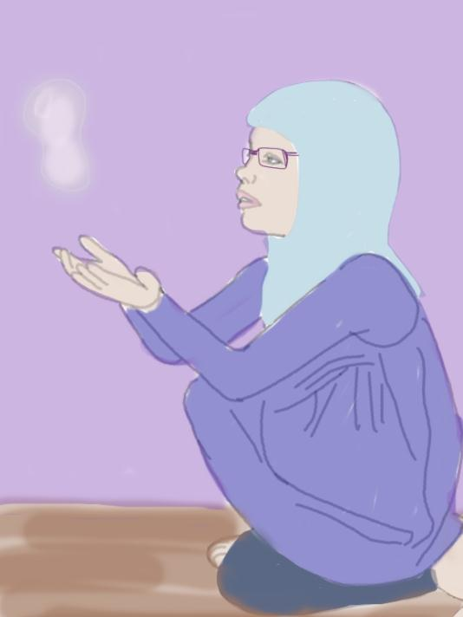
Notes:
After what seemed like a very long time, she couldn’t hear or see anything, so she crept across to the back veranda. Again there was that creepy feeling that something else was there. There were things floating around in the air around her. They were very light, and almost seemed to be glowing. She tried to catch one in her hands.

Slide 10
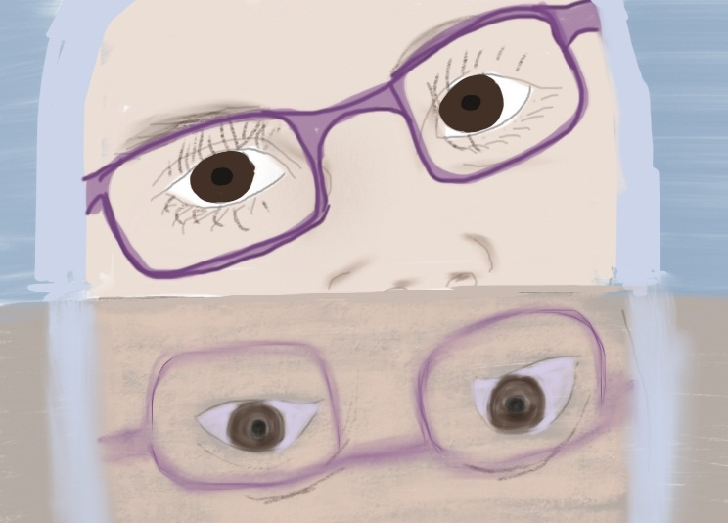
Notes:
She quietly went in through the kitchen door, and then quickly ducked down behind the table because she was sure she had heard someone else in the room. Her heart was thumping so hard she was sure anyone there would be able to hear it. Slowly she peered over the edge of the table.
Nope. Nothing to see.

Slide 11
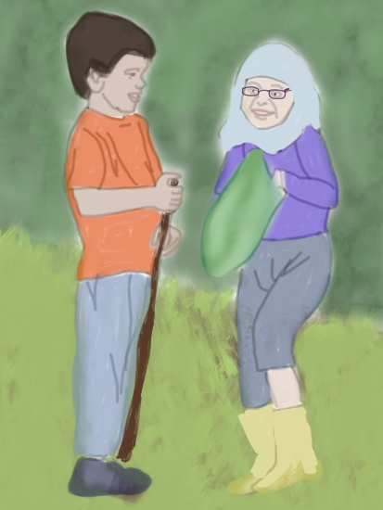
Notes:
It was the weekend and in the morning she saw Amir outside and went across to talk to him. She tried to explain to him about the night before, and he seemed to understand why she felt so frightened. But at the same time, she had the uneasy feeling that he was laughing at her underneath his sympathetic smile. Could it be that he had something to do with what she had seen last night?

Slide 12
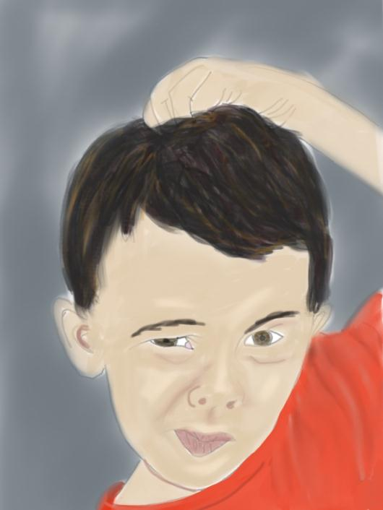
Notes:
When she told him about the funny little floating things, he got a quizzical look on his face and scratched his head thoughtfully. Sofea stared hard at him, and waited for his thoughtful scientific response.
“What?” asked Sofea.
“Did they look like bubbles?” asked Amir, as his mouth twitched into a smile.
“Amir! Did you …?” but he was gone … running away from her and laughing.

Slide 13
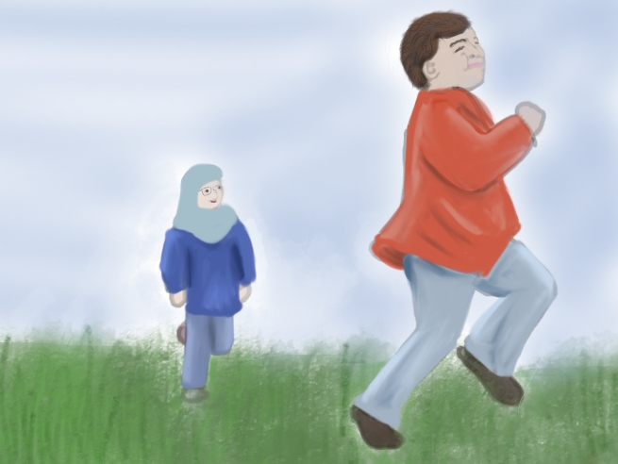
Notes:
Sofea ran after Amir, although she wasn’t sure why. She soon caught up with him, but she was too puffed to say anything.
She was a little embarrassed, but she still enjoyed having him as a friend.
It was a pretty good trick, blowing bubbles across her veranda in the dark.
She decided to get even , and she would have to be very brave to do it.

Slide 14
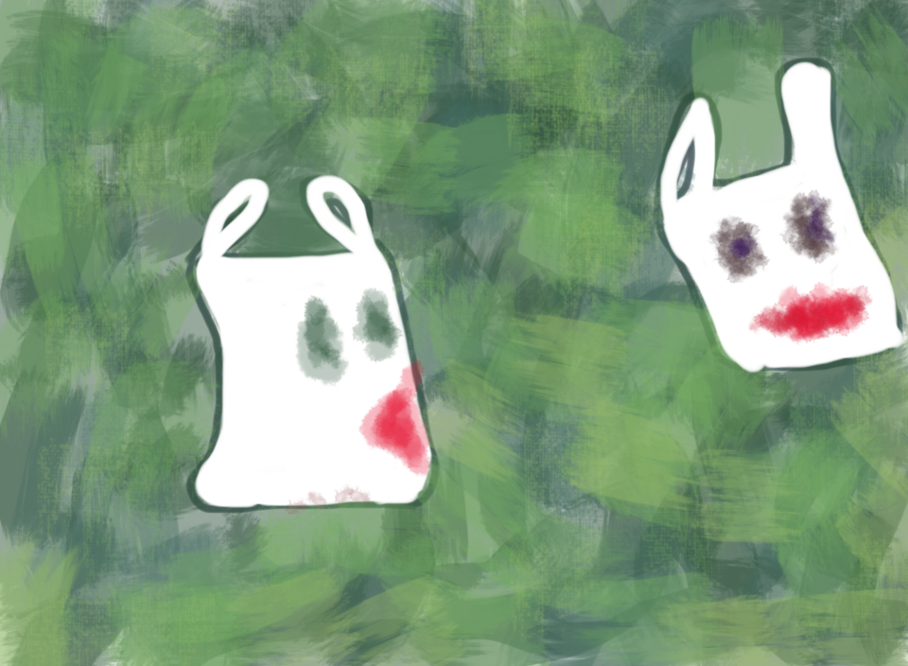
Notes:
She took some white plastic shopping bags and drew ghostly faces on them. After dark, she quietly tied them in the trees around Amir’s house, and watched as the gentle breeze filled them and made them move in a ghostly way.
Then she hid and waited.
She was surprised to find that she didn’t feel at all frightened, knowing that the only thing to be afraid of was her own plastic bags.

Slide 15
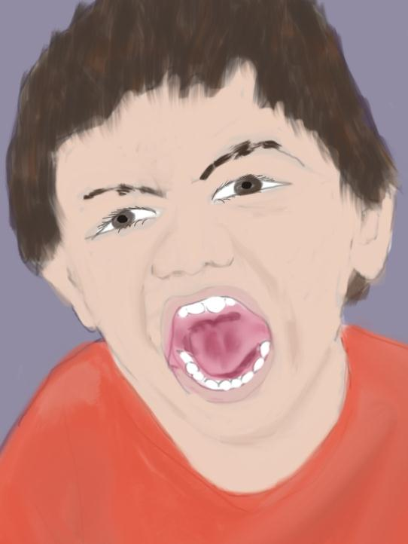
Notes:
Soon Amir came outside. He was REALLY scared when he saw the ghostly faces floating in the breeze. He seemed to be so frightened that he was having trouble speaking.
Sofea couldn’t help laughing out loud.
Amir came over to where she had been hiding and just stood there looking at her.
And then he smiled. “OK” he said, and walked back inside. Sofea went home to bed.

Slide 16
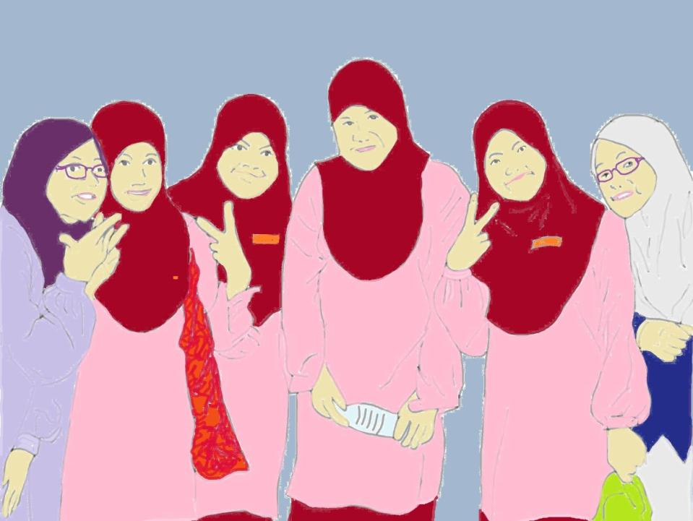
Notes:
Back at school, it was good to be with her friends. They had a lot of good laughs together, but Sofea decided not to tell them about what had happened with Amir and the bubbles and the plastic bags.
They did notice, however, that Sofea seemed to have a little private smile, and they knew that something must have happened.
“Sofea, what did you do on the weekend?” asked Maisarah.

Slide 17
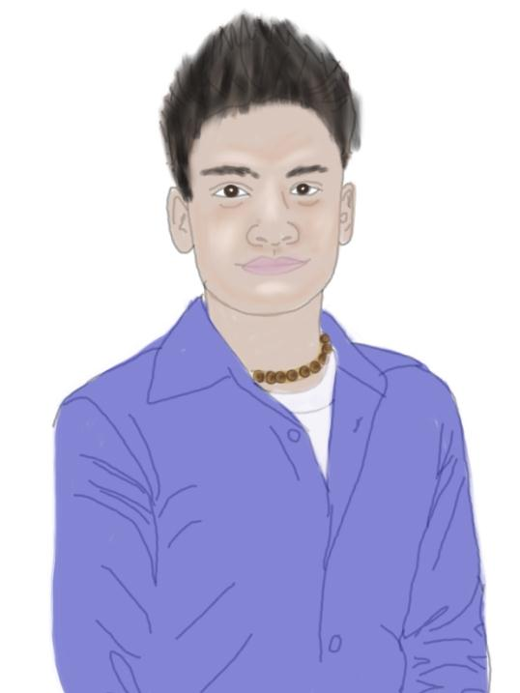
Notes:
“Oh! I had a visit from my hero!” she replied.
“Who?” asked her friends.
“I know who your hero is … It’s Randy Pangalila!” said Nadhah. “I know he didn’t come here on the weekend!”
Sofea didn’t answer. She just smiled a secret smile.

Slide 18
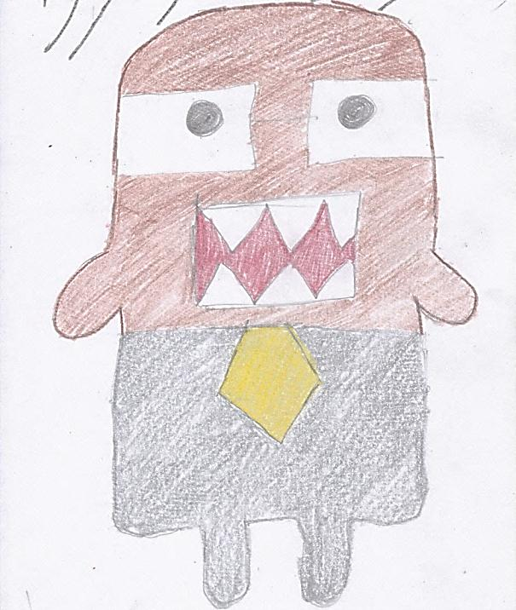
Notes:
Sofea sat in her desk with the art paper in front of her, undecided what to draw. She wanted to draw ghostly-looking bubbles floating across her veranda. Or maybe she could draw Amir’s frightened face when he saw her plastic bags.
It all seemed so strange and unreal now that they were both back in school.
In the end she drew her Domo bag …

Slide 19
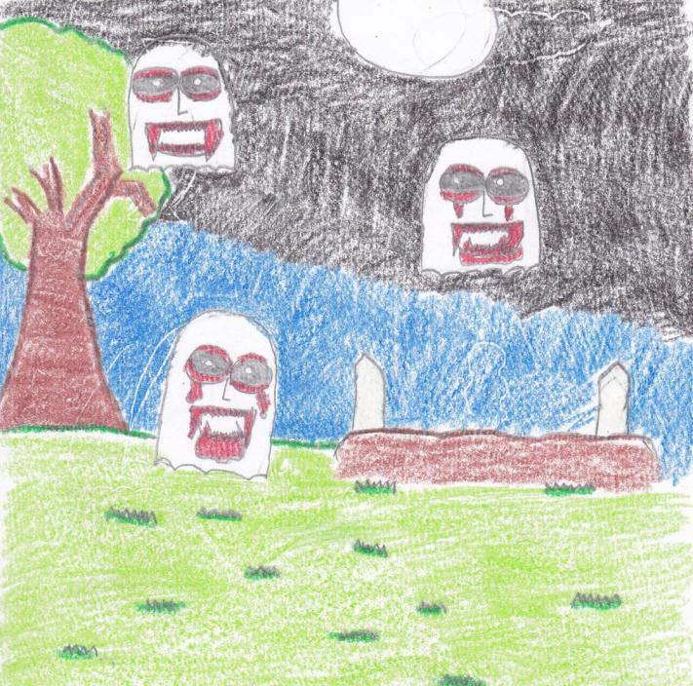
Notes:
Amir was good at drawing, and he confidently drew what he thought he had seen outside his house the other night.
Sofea left her desk and walked past his desk and peeked at his picture.
Amir looked up from his work and gave her a little smile.
No one would ever know.

Slide 20
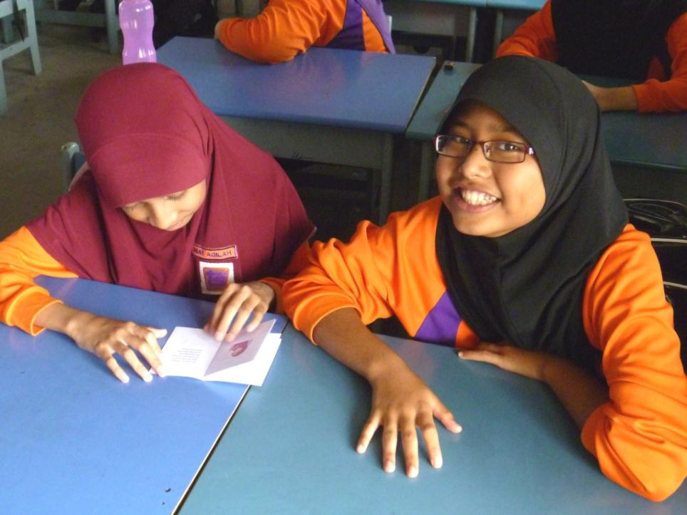
Notes:
Sofea and her friends enjoyed reading stories like this, even though they are in English. They like it because they are stories about them, and that makes it more interesting.
They hope that there will soon be lots more stories for them to read.
Maybe you could help by telling some stories about your childhood in Malaysia.

Slide 21
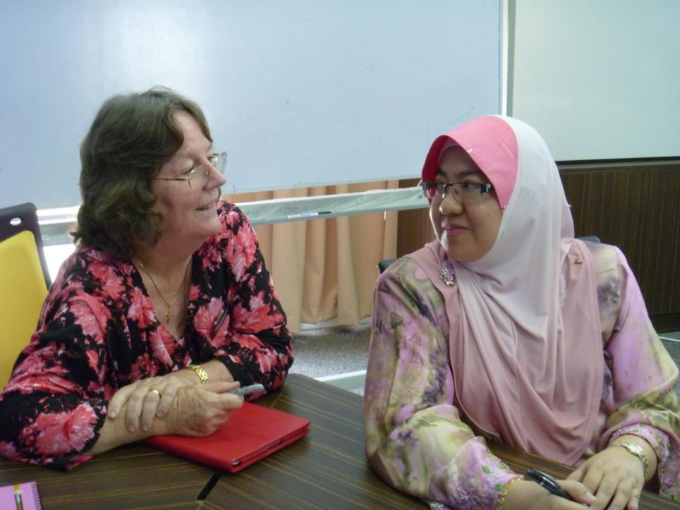
Notes:
Linda and I are working on writing stories in English for Malaysian kids.
Like this story, they are fun stories about local children in a local setting.
The point of each story is simply that stories and reading can be fun and worthwhile, especially if it is about something you can relate to.

