Slide 1
Adding Shapes and Text to Pictures on PowerPoint
A 21X20 PowerPoint Stage 2 Production
by Peter Wickham
Notes:
I want to show you a 21X20 PowerPoint Stage 2 slideshow that was constructed by Peter Wickham at IPGKDRI in Kuala Terengganu, Malaysia. This demonstrates the basic 21X20 style, being 20 slides long and each slide advancing after 20 seconds.

Slide 2
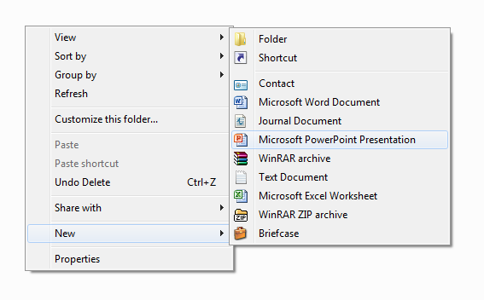
Notes:
Preparing a 21X20 PowerPoint Stage2 is easy when you know how. To begin, click the right-hand mouse button. The file will be created in whatever location you are in on your computer at the time. Choose New, and then from the pop-out dialogue box, choose Microsoft PowerPoint Presentation.

Slide 3
Notes:
You will need to give your new file a name that is easy to distinguish from other PowerPoint files that you may have on your computer. It would be clever to include enough information in the name for you to be able to spot it easily when you come to look for it later.

Slide 4
Notes:
It is wise to always include your name in the file name. Other useful information might be the date, location, occasion, and purpose of the file. Too much information might force Windows to hide some of it, so you have to decide the best name in the shortest space. Here I have shortened PowerPoint to PPt.

Slide 5
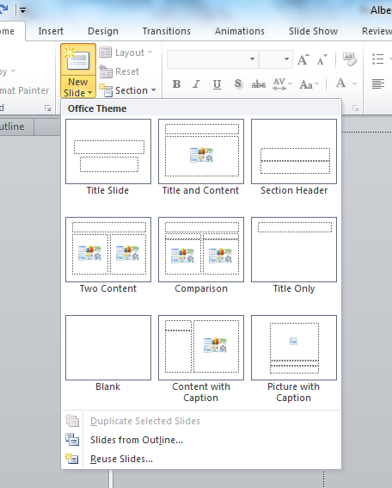
Notes:
Open your new file. Begin by selecting New Slide and choosing the Blank option. This means that you no longer have those annoying text boxes on the screen. They can be useful in other circumstances, but not here. Once you have chosen this option it becomes the default for the rest of this presentation.

Slide 6
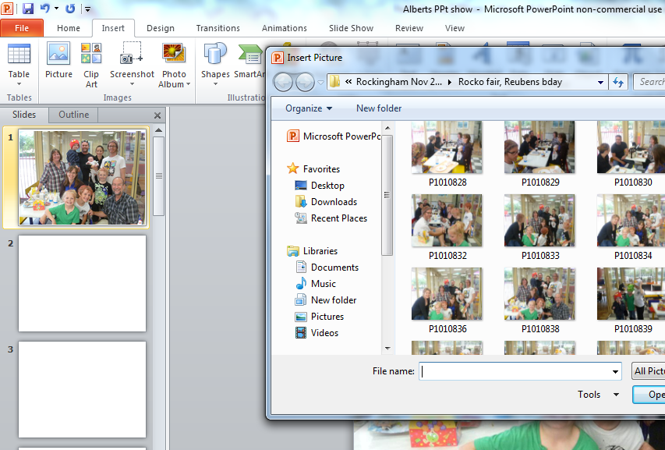
Notes:
Click on the Insert ribbon and choose Picture. Navigate through your computer folders until you find the picture you want. Click on it. It will then appear on your slide. You can expand or reduce your picture with the grab handles on the sides and corners.

Slide 7
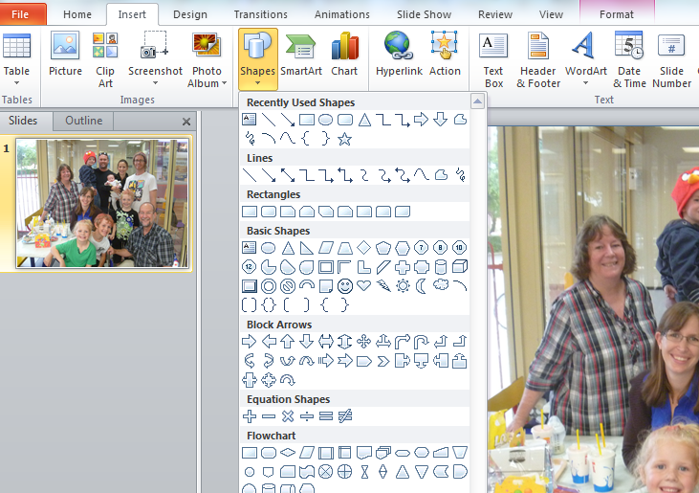
Notes:
I want to add an arrow pointing to the cute little one in the centre of the photo. I click on Insert, then Shapes, then I choose an arrow to insert. There are many shapes to choose from, and each of them can be edited.

Slide 8
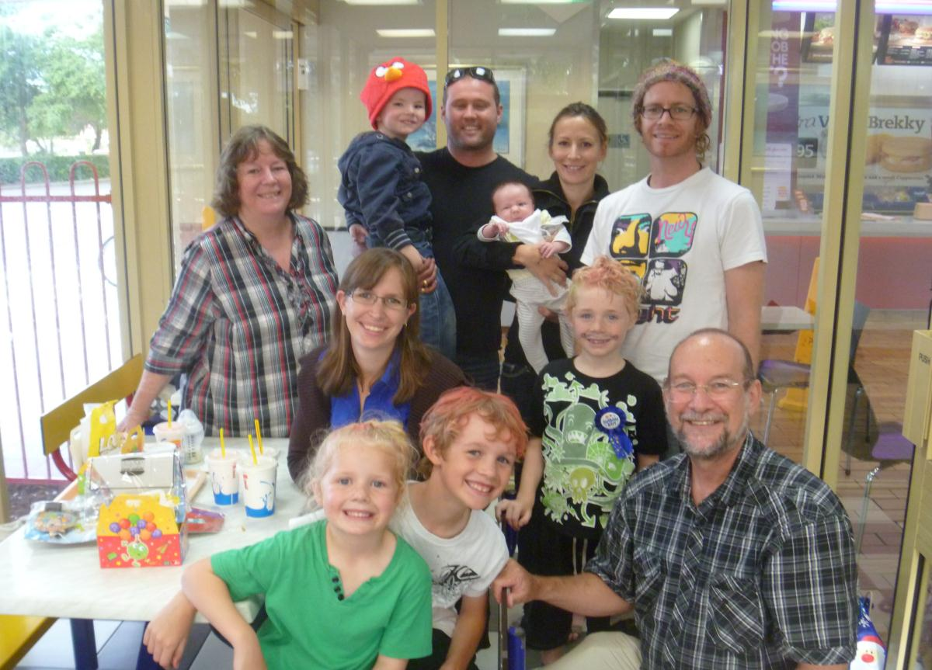
Notes:
The arrow can hardly be seen in this photo. I have put a yellow circle around it here to show you where it is. It is a thin blue line on a dark background, so we need to change its thickness and colour. I have dragged the arrow into place and rotated it using the rotator grab handle.

Slide 9
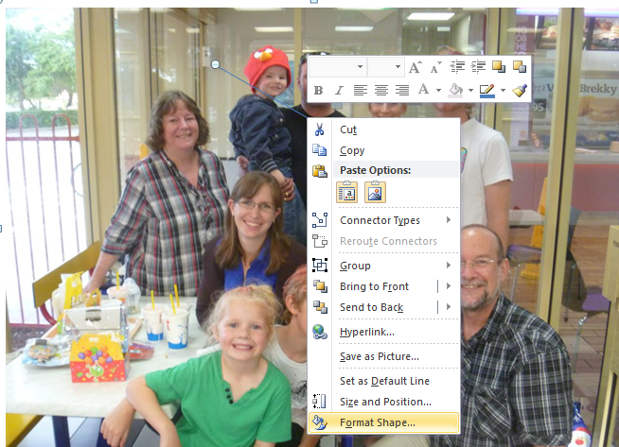
Notes:
To edit this Shape, click the right-hand mouse button while the cursor is on the Shape and choose Format Shape. This will open up a huge choice of colours, line types, line thickness, fills and special effects.

Slide 10
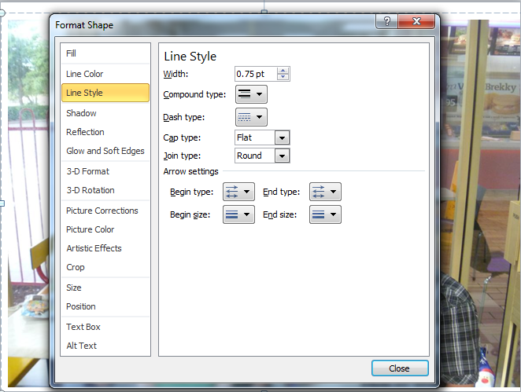
Notes:
I want to make the arrow shape thicker so that it is more visible. The default thickness if 0.75 point. This can be seen when I click on Line Style. You can see that I can also change the lines to dashes instead of continuous, and I can change the types of end the arrow has. For now, I am only interested in thickness.

Slide 11
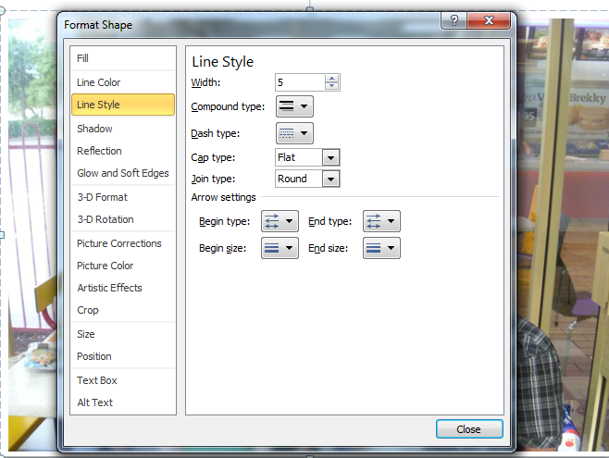
Notes:
I can either use the up and down arrows to increase or decrease the line thickness, or I can click in the number box and type in 5, as I did here. When I return to my slide, the line thickness will now be greatly increased.

Slide 12
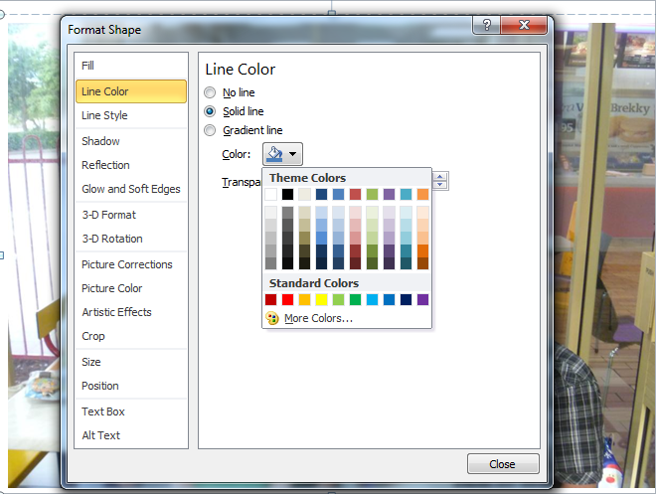
Notes:
And now a most important step – Line Colour. By clicking on the Line Colour tab near the top I can choose from a great variety of colours. It is best to choose a colour that contrasts with its background colour. The whole reason for adding a shape is to draw attention to itself and a feature of the picture, so it should be attention-grabbing.

Slide 13
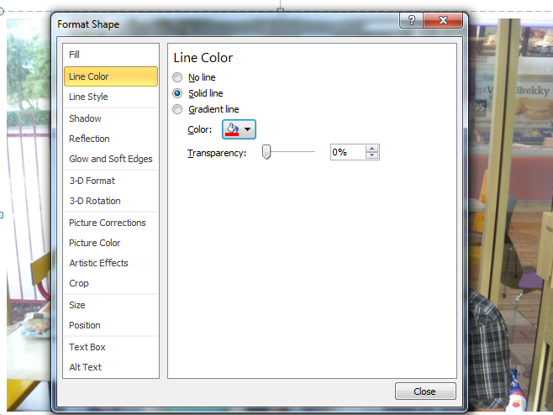
Notes:
You will know that you have been successful in changing the colour when you can see the underlining under the little bucket is now the colour that you chose. To finish with editing the shape, simply click on the Close button at the bottom of the dialogue box. This will take you back to your slide, with all of your changes to the shape in place.

Slide 14
Notes:
My arrow is now pointing at young Thomas. It is much more visible, now being thick and bright red. It contrasts nicely with the dark background and draws attention to the smallest person in the picture. The purpose of this arrow is to point to Thomas with a comment, which I will now add in a Text Box.

Slide 15
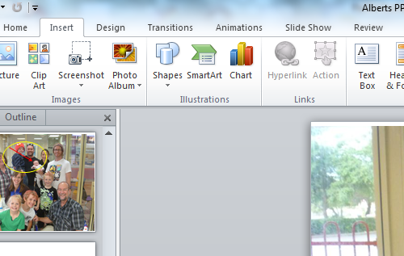
Notes:
Once again I click on the Insert Ribbon and then this time on Text Box. A Text Box is just the same in PowerPoint as in Word. It gives you a box to type into with all of the normal Office editing tools. It can be moved around the page as a separate object from the rest of the page. In PowerPoint a Text Box can be place over the top of other objects.

Slide 16
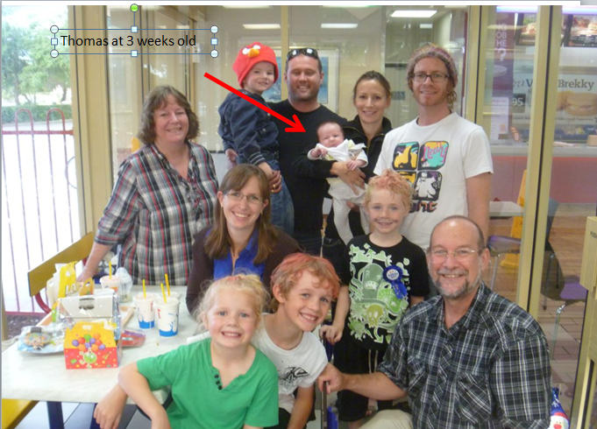
Notes:
By clicking inside my Text Box I have been able to type “Thomas at 3 weeks old” into the Text Box and therefore onto the picture next to the arrow. Unfortunately the text is almost invisible because it is black on a dark background, very thin , and very small. Fortunately I can fix that by clicking on the Text Box and making sure that I am on the Home ribbon.

Slide 17
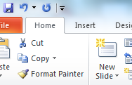
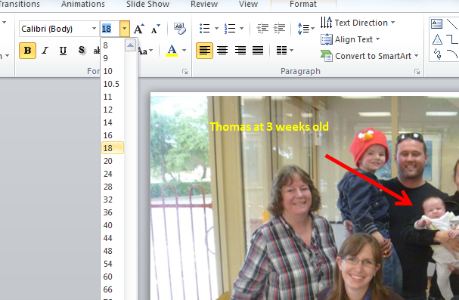
Notes:
This now gives the picture a focus. By highlighting the text I have then chosen Bold, 18 point font and Yellow colour. These are all found in the same places as in Word on the Home ribbon. I have chosen to have no border around the text to unclutter the slide.

Slide 18
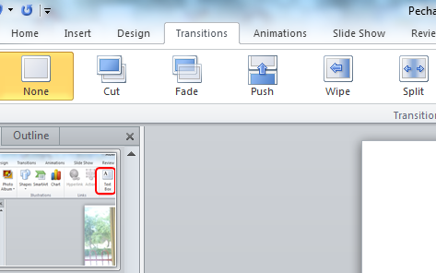
Notes:
An awful lot of Transitions are available on the Transitions ribbon. Transitions are the way that one slide disappears from view and the next slide appears in its place. It is fun to play with the different Transitions. Many of them are most professional-looking and interest-grabbing. You have to be careful that they do not overpower the content and message of the slide.

Slide 19
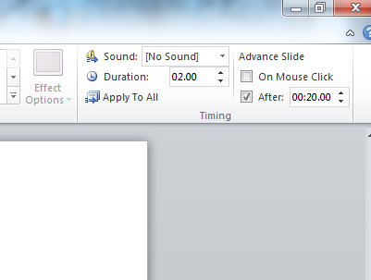
Notes:
In the Transitions ribbon, over on the right, is the Advance Slide feature. The default is the Advance on Mouse Click which most people use all of the time. For 21X20 purposes, though, we want Advance Slide After 20 seconds. I have Clicked on the After box and changed the time to 20 seconds. My slides now move on automatically every 20 seconds.

Slide 20
Notes:
When I use Clipping tools I can easily add a screen shot of anything that appears on my screen to my slides. This is especially useful in showing an audience something that happens on my screen during an application. Windows button plus “s” at the same time opens up the screen to be clipped.

Slide 21
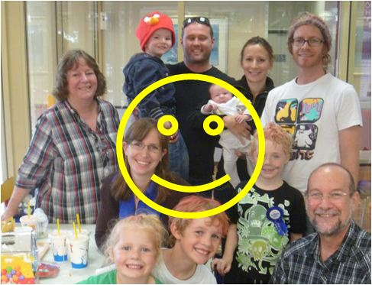
Notes:
I can even add on-screen notes and humorous touches to my PowerPoint slides that make them really come alive, and just as importantly, keep my audience awake through the entire performance. This has been a 21X20 PowerPoint Stage 2 production. Thankyou for listening.

