Slide 1
PECHA KUCHA LIFE IN IPGKDRI THEME: SOCIAL LIFE
DATE: 22ND MAY 2012
BY:
NUR ATHIRAH BT MOHD ALIZAN
AFIFAH BT ABDULLAH
UNIT: TESL 3

Slide 2
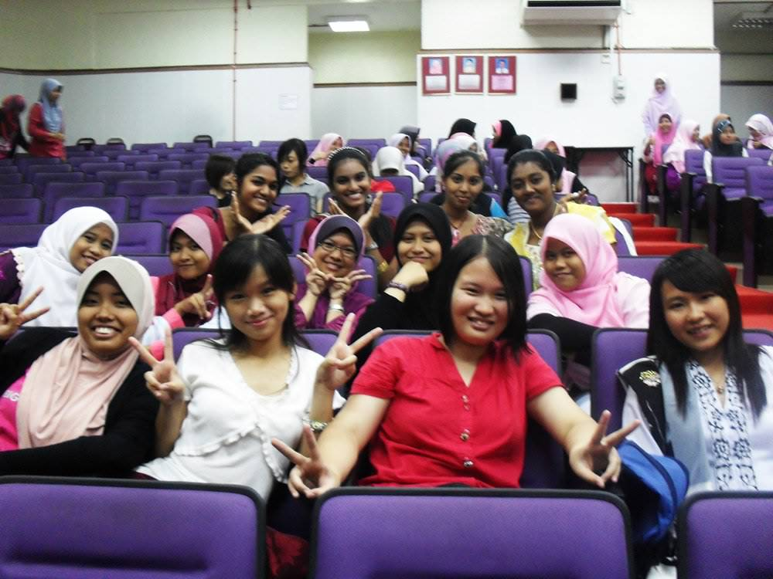
Notes:
THIS IS OUR FIRST CULTURE NIGHT IN IPG KDRI.
FYI, THE EVENT WAS ONLY FOR GIRLS.
REMEMBER?
ON THAT NIGHT,THERE WAS A MULTICULTURAL PERFORMANCE WHICH INVOLVE ALL THE RACES IN IPG KDRI.
EXCITED ISN’T IT?

Slide 3
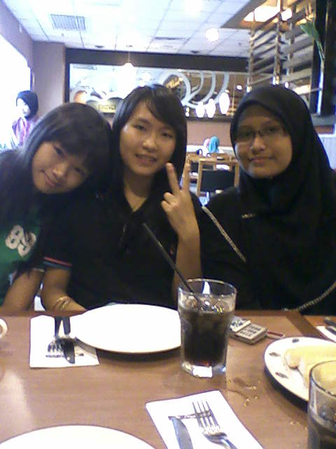
Notes:
NEXT, THIS IS OUR FIRST OUTING WITH OUR CLASSMATES WHEREBY WE WENT TO PIZZA HUT.
THERE WERE 8 OF US ENJOY EATING TWO LARGE PIZZAS WHILE KNOWING EACH OTHER BETTER.
THIS IS THE STARTING OF OUR SOCIAL LIFE IN IPG.
WELL, IT WAS A WONDERFUL MOMENT THAT WE HAD.

Slide 4
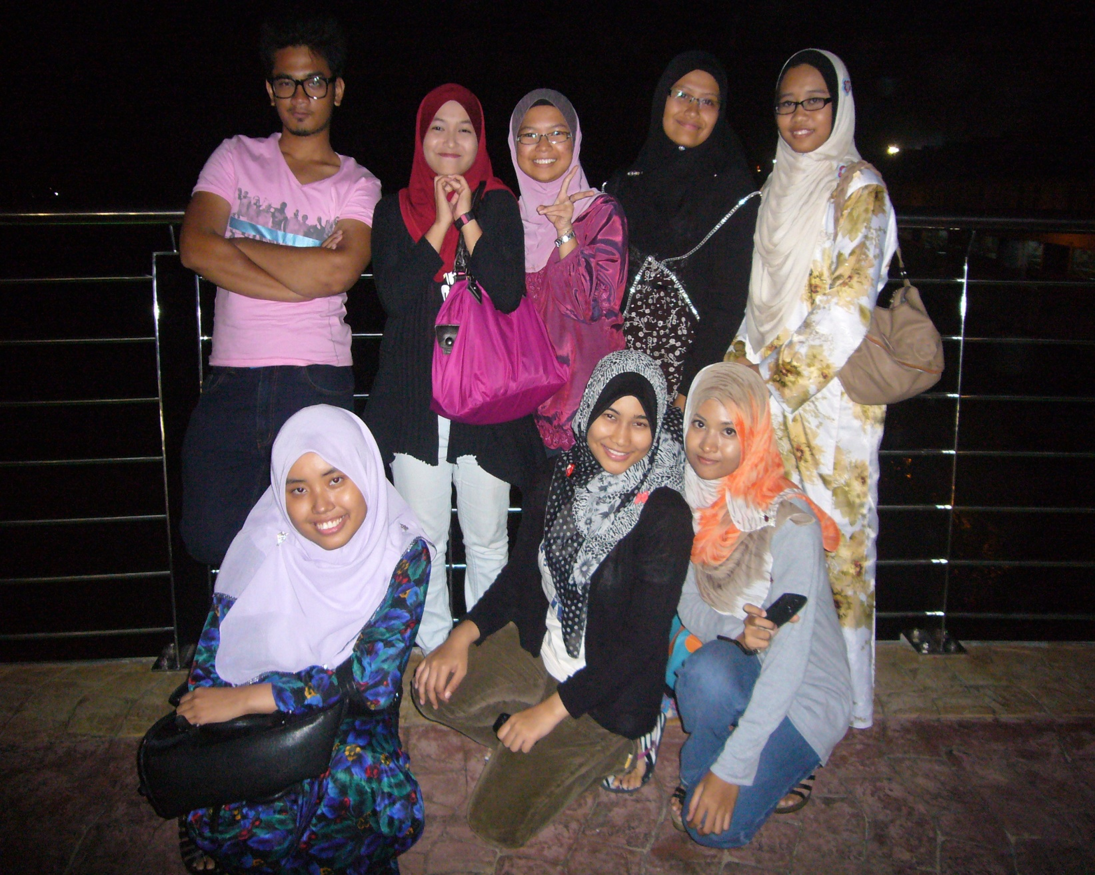
Notes:
THIS PICTURE WAS TAKEN WHEN WE WERE AT ICT KUALA TERENGGANU WHICH IS LOCATED BEHIND CHINATOWN.
WE WERE AT THE CENTRE OF THE BRIDGE WHERE WE CAN SEE THE RIVER FLOWS CALMLY.
AS IT WAS NIGHT, WE CAN FEEL THE COOLNESS OF THE BREEZE THERE.
AT THE SAME TIME, WE WERE SHOOTING FOR OUR SOCIAL STUDIES ASSIGNMENT.

Slide 5
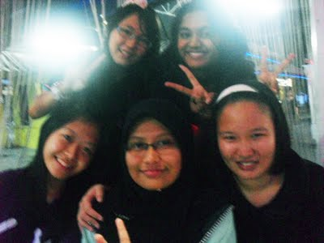
Notes:
DURING RAMADHAN LAST YEAR, WE WENT TO BATU BUROK TO HAVE A MEAL AFTER ONE DAY FASTING FOR MUSLIM.
AS WE WERE WALKING, THERE WAS A MAN WHO CLAIM THAT WE ARE ONE MALAYSIA.
WE ALSO PLAYED AT THE PLAYGROUND NEARBY AFTER HAVING THE DINNER.
IT WAS SUCH A GREAT OUTING AS IT TIGHTENED OUR FRIENDSHIP.

Slide 6
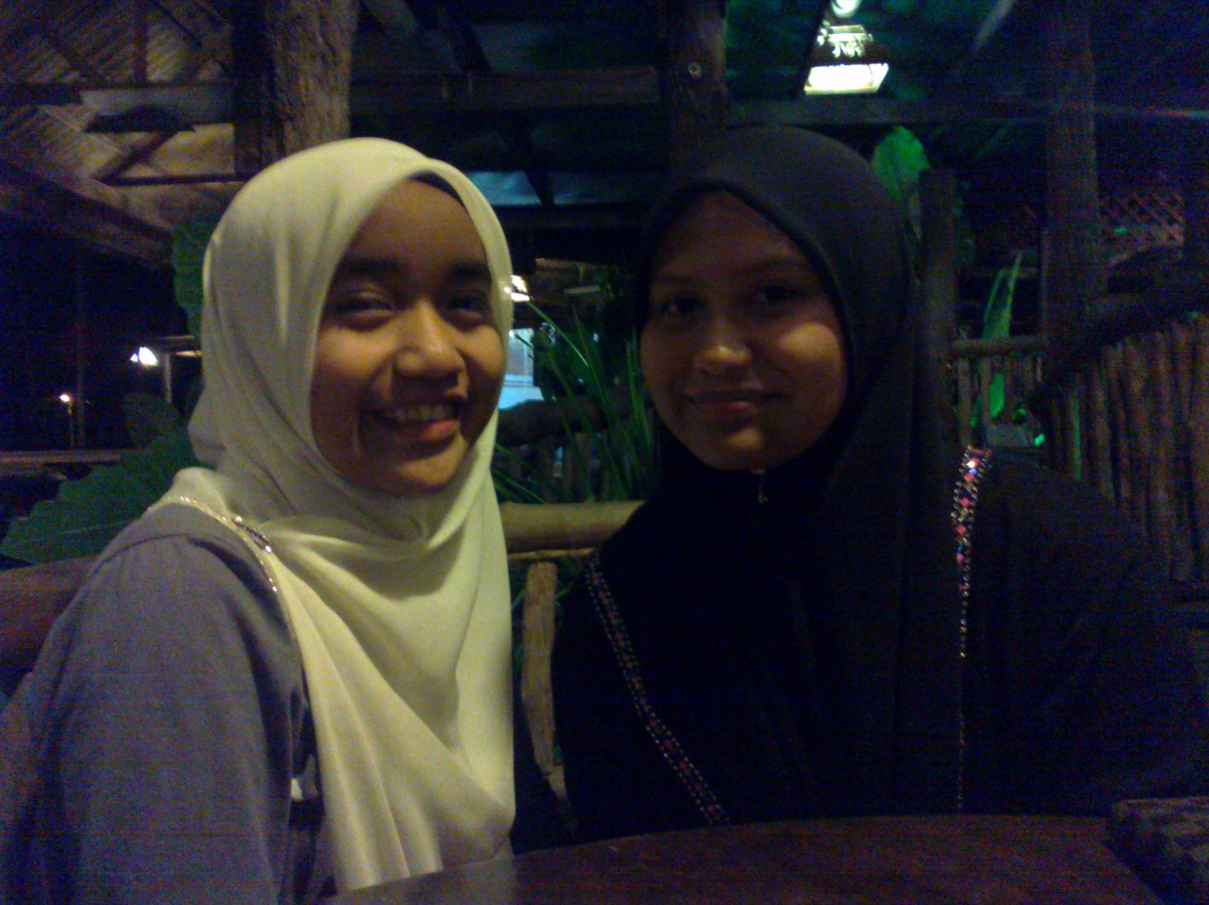
Notes:
WE SUGGESTED ALL OF YOU TO GO TO NR CAFÉ FOR THOSE WHO NEVER BEEN THERE.
IT WAS SUCH A SUPERB RESTAURANT WHERE YOU CAN HAVE YOUR WESTERN AND TYPICAL MALAY MEALS.
THE ATMOSPHERE WAS REALLY CONDUSIVE AS IT LOCATED AT THE SEASIDE OF PANTAI MENGABANG TELIPOT.
AND THE FOOD WAS MMMM, YUMMY!

Slide 7
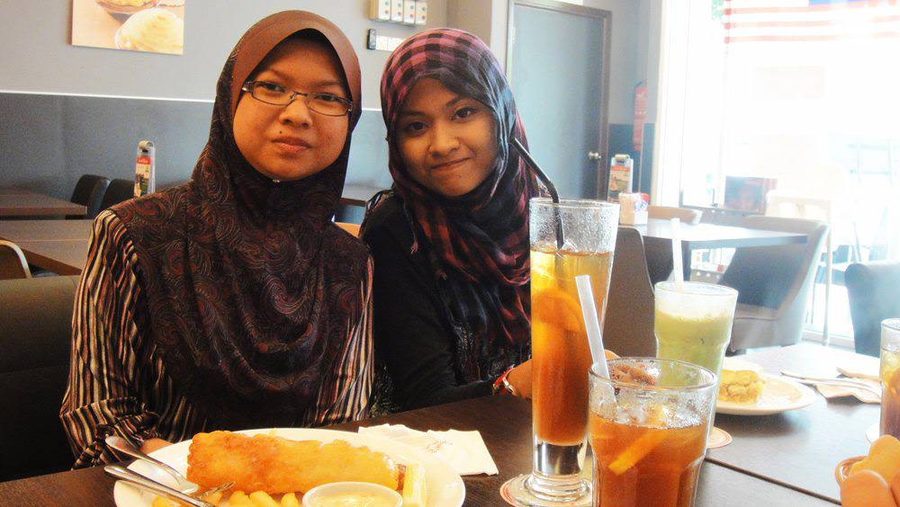
Notes:
THE UNFORGETTABLE SECRET RECIPE WHERE WE CAN FIND VARIETY OF CAKES.
THIS WAS THE FIRST PLACE WE WENT AFTER WE GOT OUR ALLOWANCE.
WE ATE THE MANY MOUTH-WATERING AS OUR SNACK BEFORE WE WENT FOR A SHOPPING.
AFTER ALL, IT IS ALL ABOUT EATING.

Slide 8
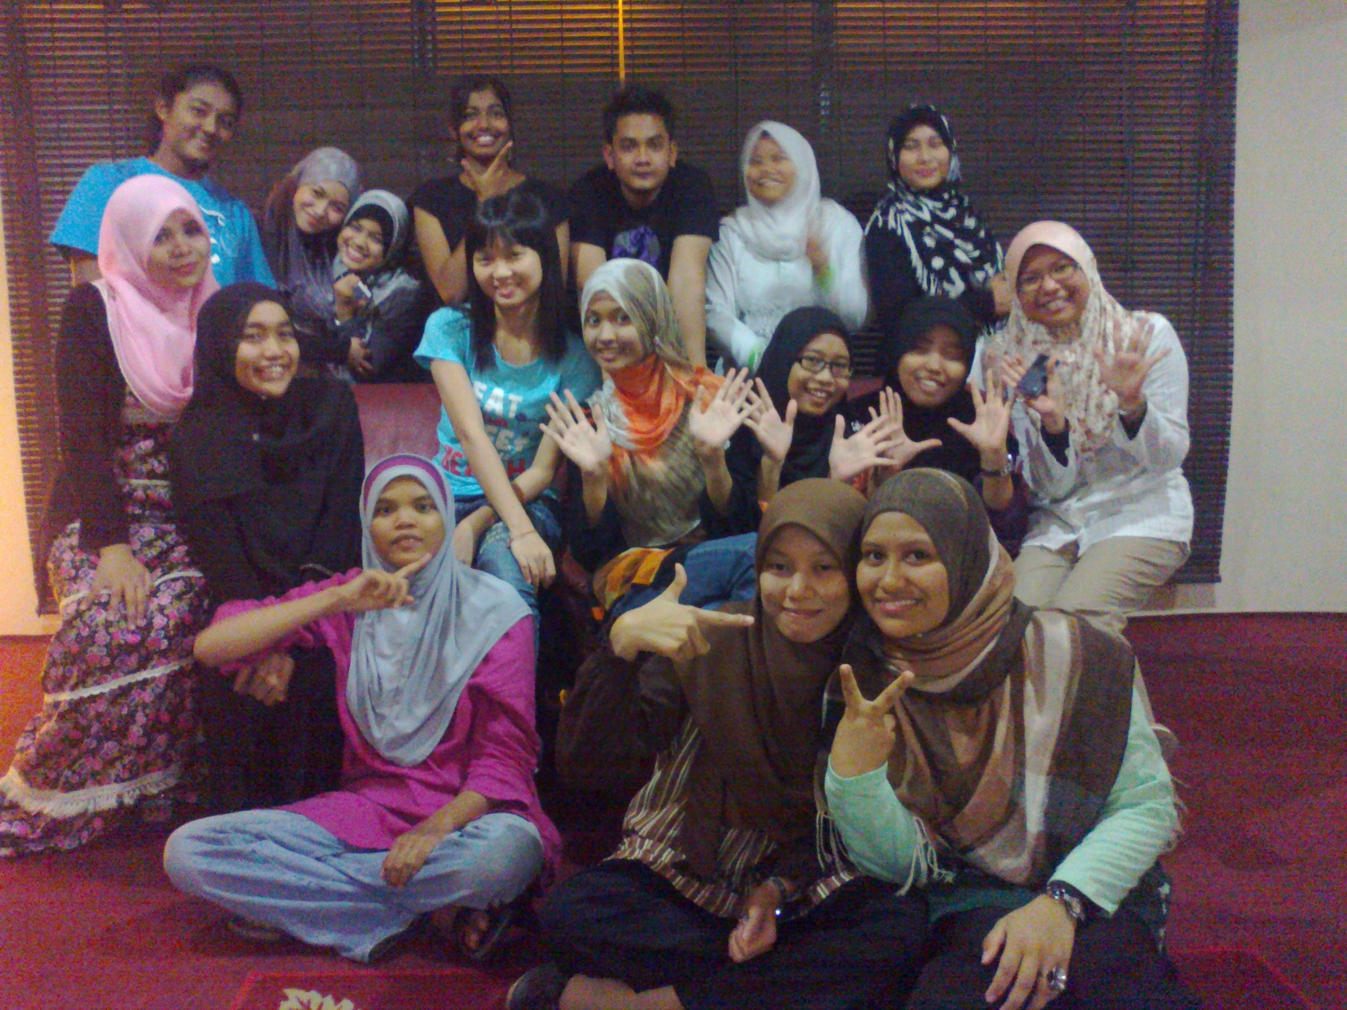
Notes:
BESIDES, WE ALSO HAD OUR SOCIAL LIFE BY HAVING DINNER TOGETHER DURING RAMADHAN WITH OUR TUTOR, MADAM FAIZAH.
THIS NICE RESTAURANT CALLED BB SEAFOOD IS LOCATED NEAR UNISZA.
WE HAD A WARMING PECHA KUCHA AND COMMENTED ABOUT THE FOOD THAT WE ATE.
BUT IT WAS A POSITIVE COMMENTS AS THE FOOD WAS TASTY AND TOTALLY FUN.

Slide 9
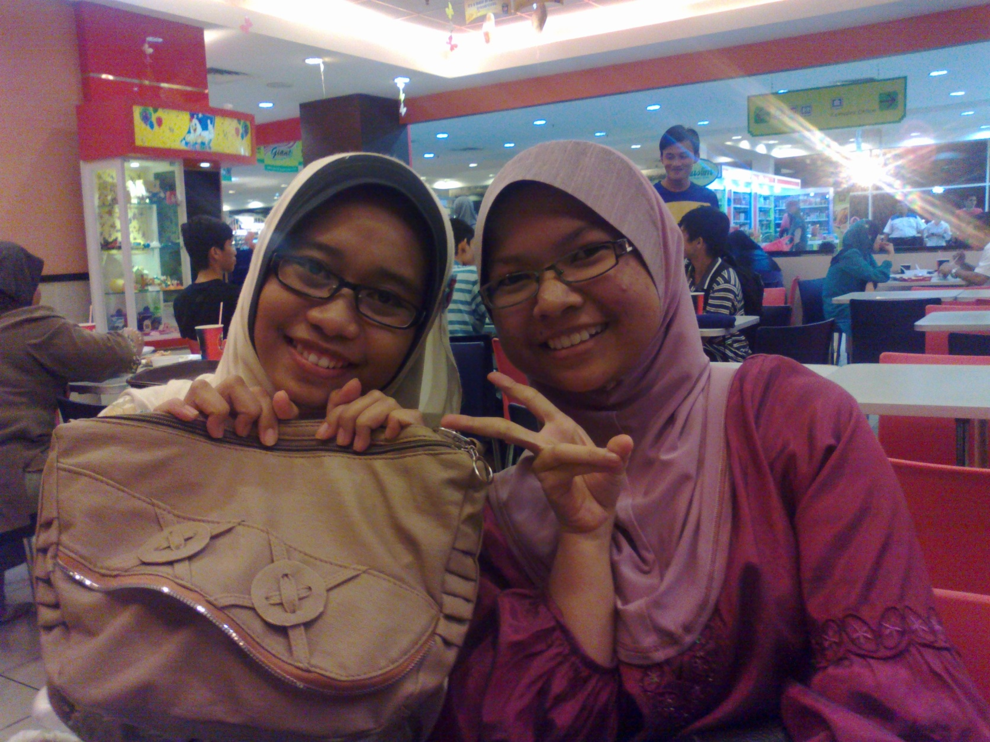
Notes:
ITS FINGER LICKIN’ GOOD! USUALLY WE WENT TO KFC BEFORE OR AFTER WE WENT SHOPPING AT GIANT OR MYDIN.
WELL, IT A WELL-KNOWN FAST FOOD RESTAURANT THROUGHOUT THE WORLD.
MAKE US EASY, SAVE TIME, GOOD SERVICE, AND ABSOLUTELY AFFORDABLE.
THE MOST IMPORTANT THING IS WE CAN SIMPLY HANG OUT THERE ANYTIME AND EVEN SURFING INTERNET.

Slide 10
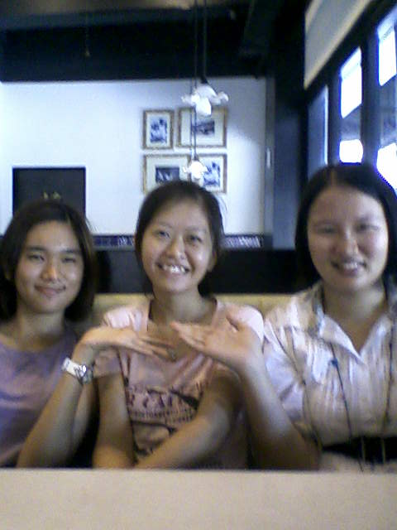
Notes:
WE WERE CELEBRATING PEI QIN’S BIRTHDAY AT THE OLD TOWN WHITE COFFEE AT THAT TIME.
THERE WERE FIVE OF US AND WE TREATED PEI QIN AND IT IS A PLEASURE TO HAVE A COFFEE, MANY TYPES OF COFFEE TO BE CHOOSE.
TRULY ENJOYED OURSELVES AND INTERESTING PLACE TO CELEBRATING BIRTHDAY ALTHOUGH IT WAS A BIT HARD TO FIND THIS OLD TOWN WHITE COFFEE.

Slide 11
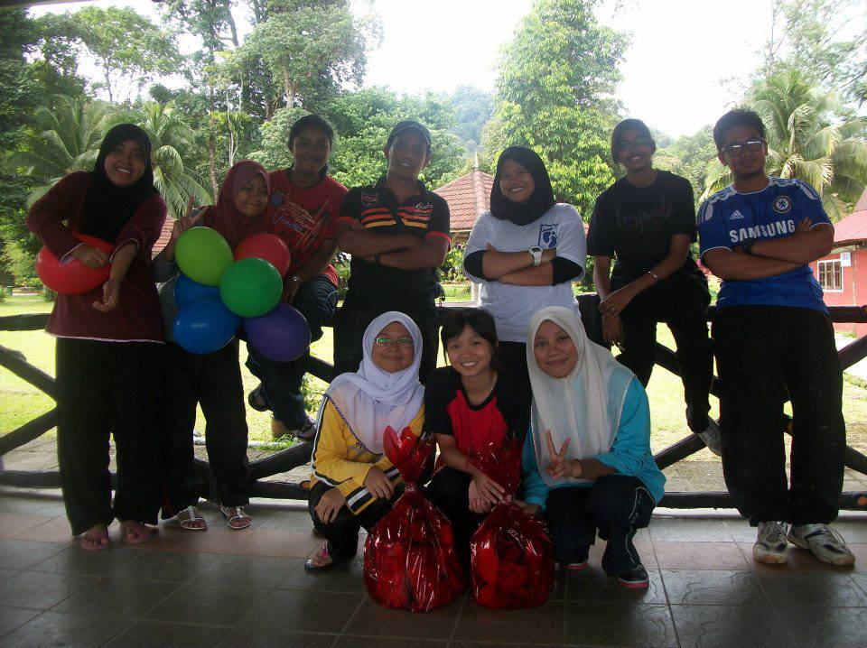
Notes:
MOREOVER, WE ALSO WENT TO AGRO RESORT DURING OUR GERKO PROJECT.
THERE WAS A LOT OF ACTIVITIES THAT WE CAN FIND AT AGRO RESORT.
IT STRENGHTENED THE BOND BETWEEN US AND MAKE US MORE TOLERATE AMONG EACH OTHER.
THE COOPERATION CAN BE SEEN THROUGHOUT THE PROJECT.

Slide 12
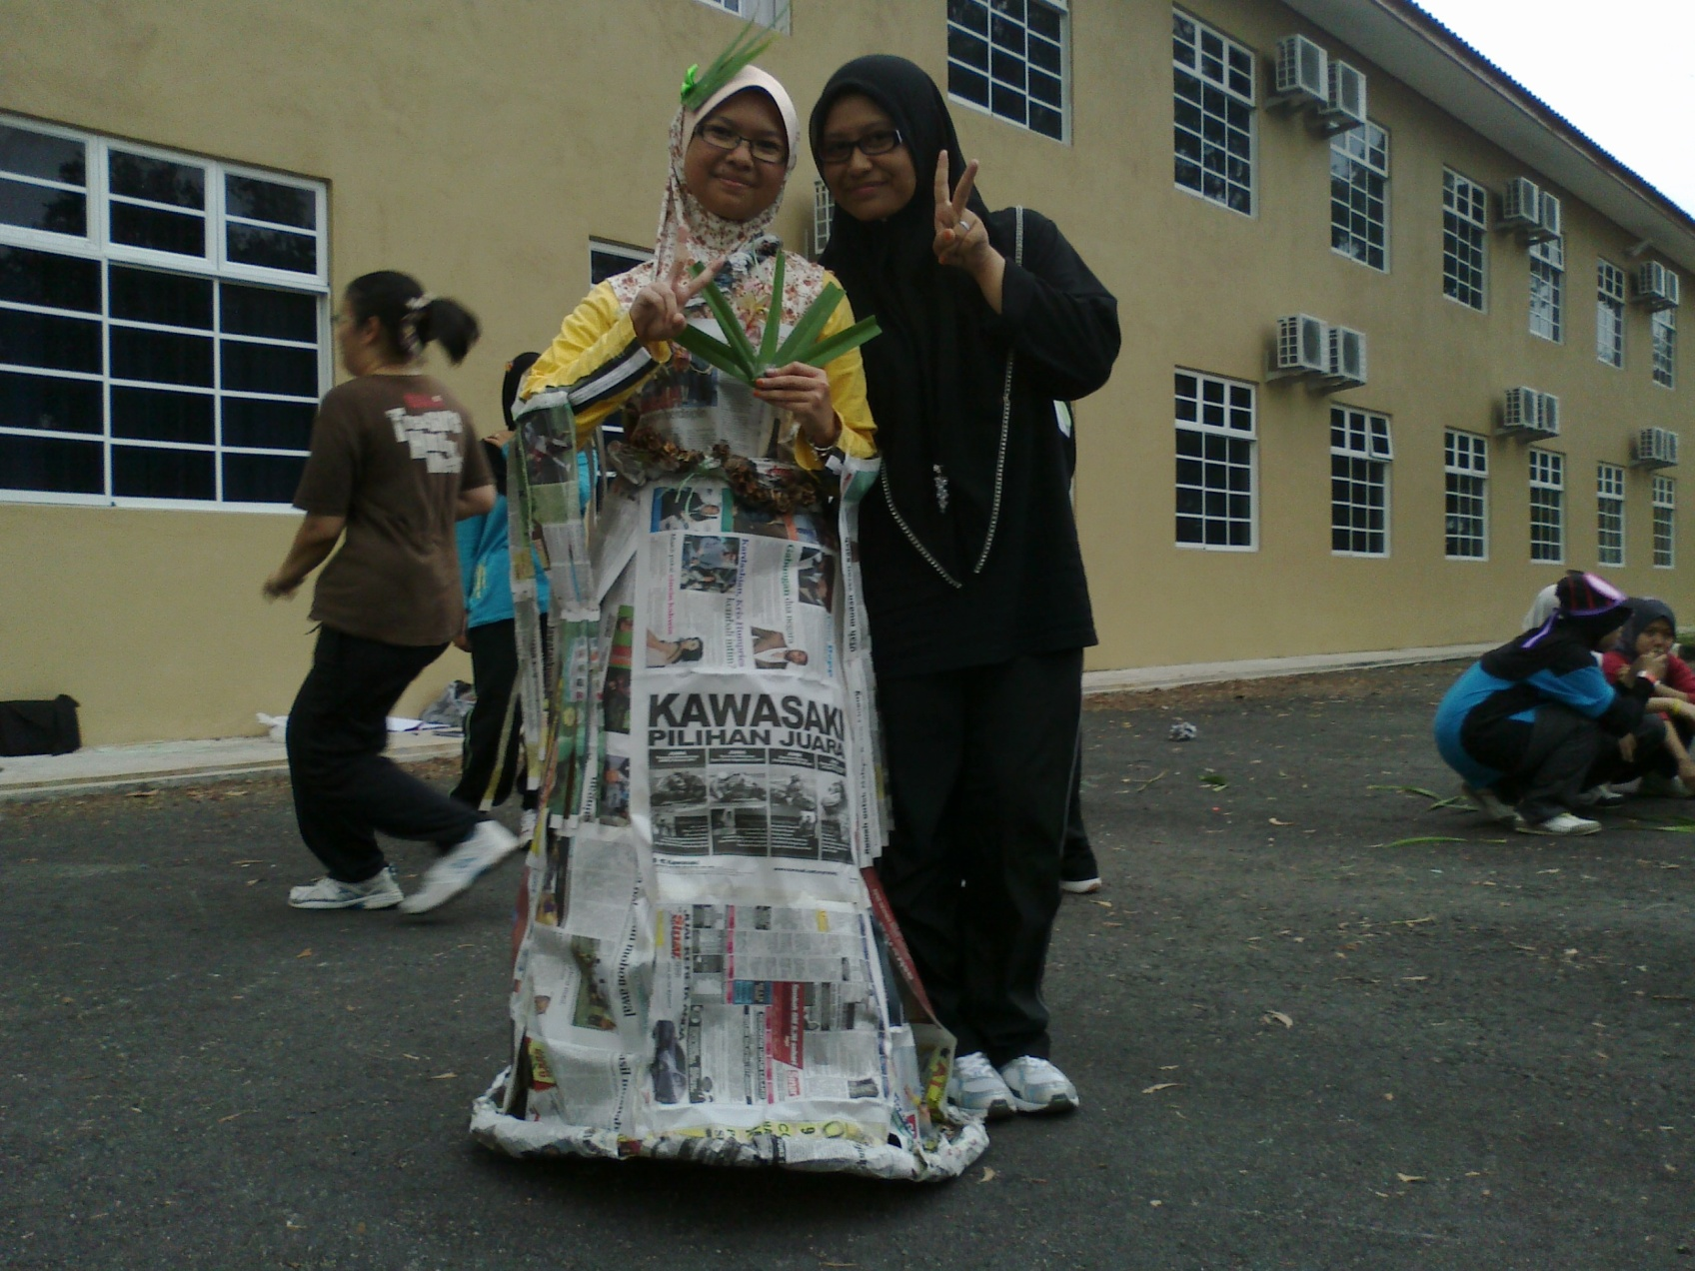
Notes:
AS AN ENGLISH STUDENT, OF COURSE WE NEED TO ATTEND ENGLISH CAMP AS A PART OF OUR SOCIETY.
THE ENGLISH CAMP WAS HELD AT KEM PENGAKAP TELAGA BATIN NEAR TO PANTAI TELUK KETAPANG.
THIS PICTURE HAD BEEN TAKEN DURING THE GLOBAL WARMING CUSTOME ACTIVITY.
IT WAS PRINCESS GOWN THAT WAS MADE BY THE NEWSPAPERS.

Slide 13
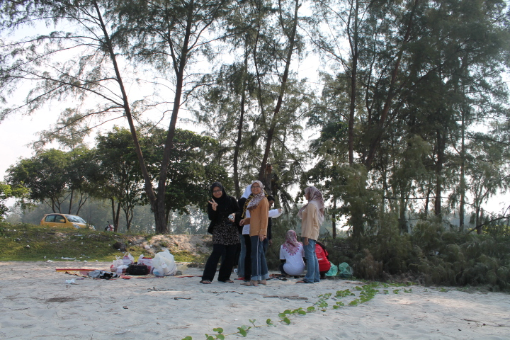
Notes:
LAST SUNDAY, WE WENT FOR A CLASS PICNIC AT PANTAI CHENDERING.
WE HAD BEEN TO FEWER BEACH, BUT WE THINK THE BEACH WAS SO AMAZING AND WONDERFUL.
WE EVEN CAN SWIM THERE AND LOOK AT THE AQUATIC LIFE IN FRONT OF OUR EYES.
WE DID A BARBEQUING AND ENJOY THE EVENING BREEZE.

Slide 14
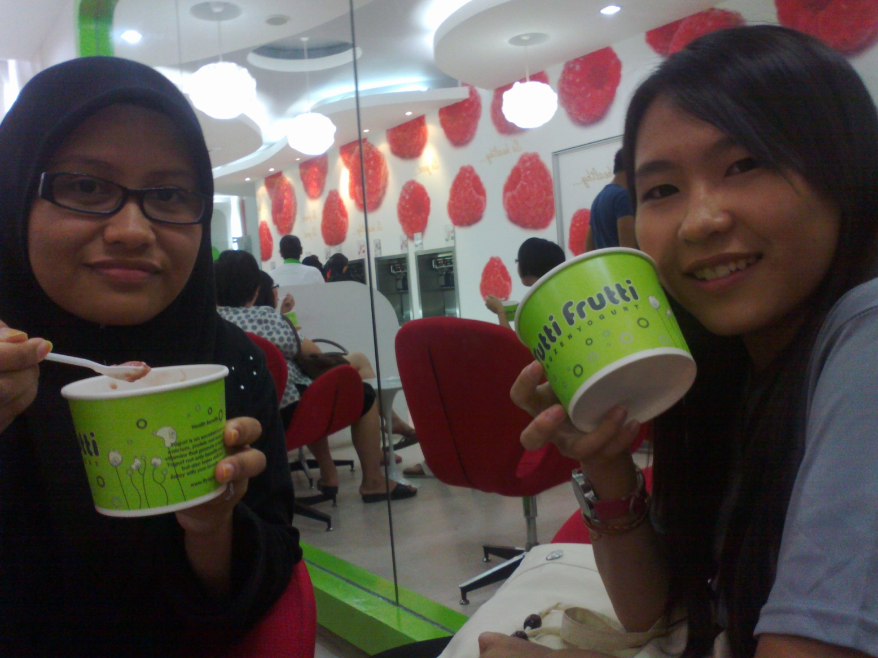
Notes:
WELL, AS YOU KNOW TUTTI FRUTTI HAD JUST OPENED THEIR BRANCH IN TERENGGANU.
OF COURSE WE DID NOT WANT TO MISS A CHANCE TO TASTE THIS YOGHURT ICE-CREAM.
ALTHOUGH IT WAS A BIT EXPENSIVE, IT IS WORTH TO BE THERE.
BUT, CONSIDERABLE THIS IS NOT A PLACE TO HANG OUT AS WE CAN RAN OUT OF MONEY AFTER THAT.

Slide 15
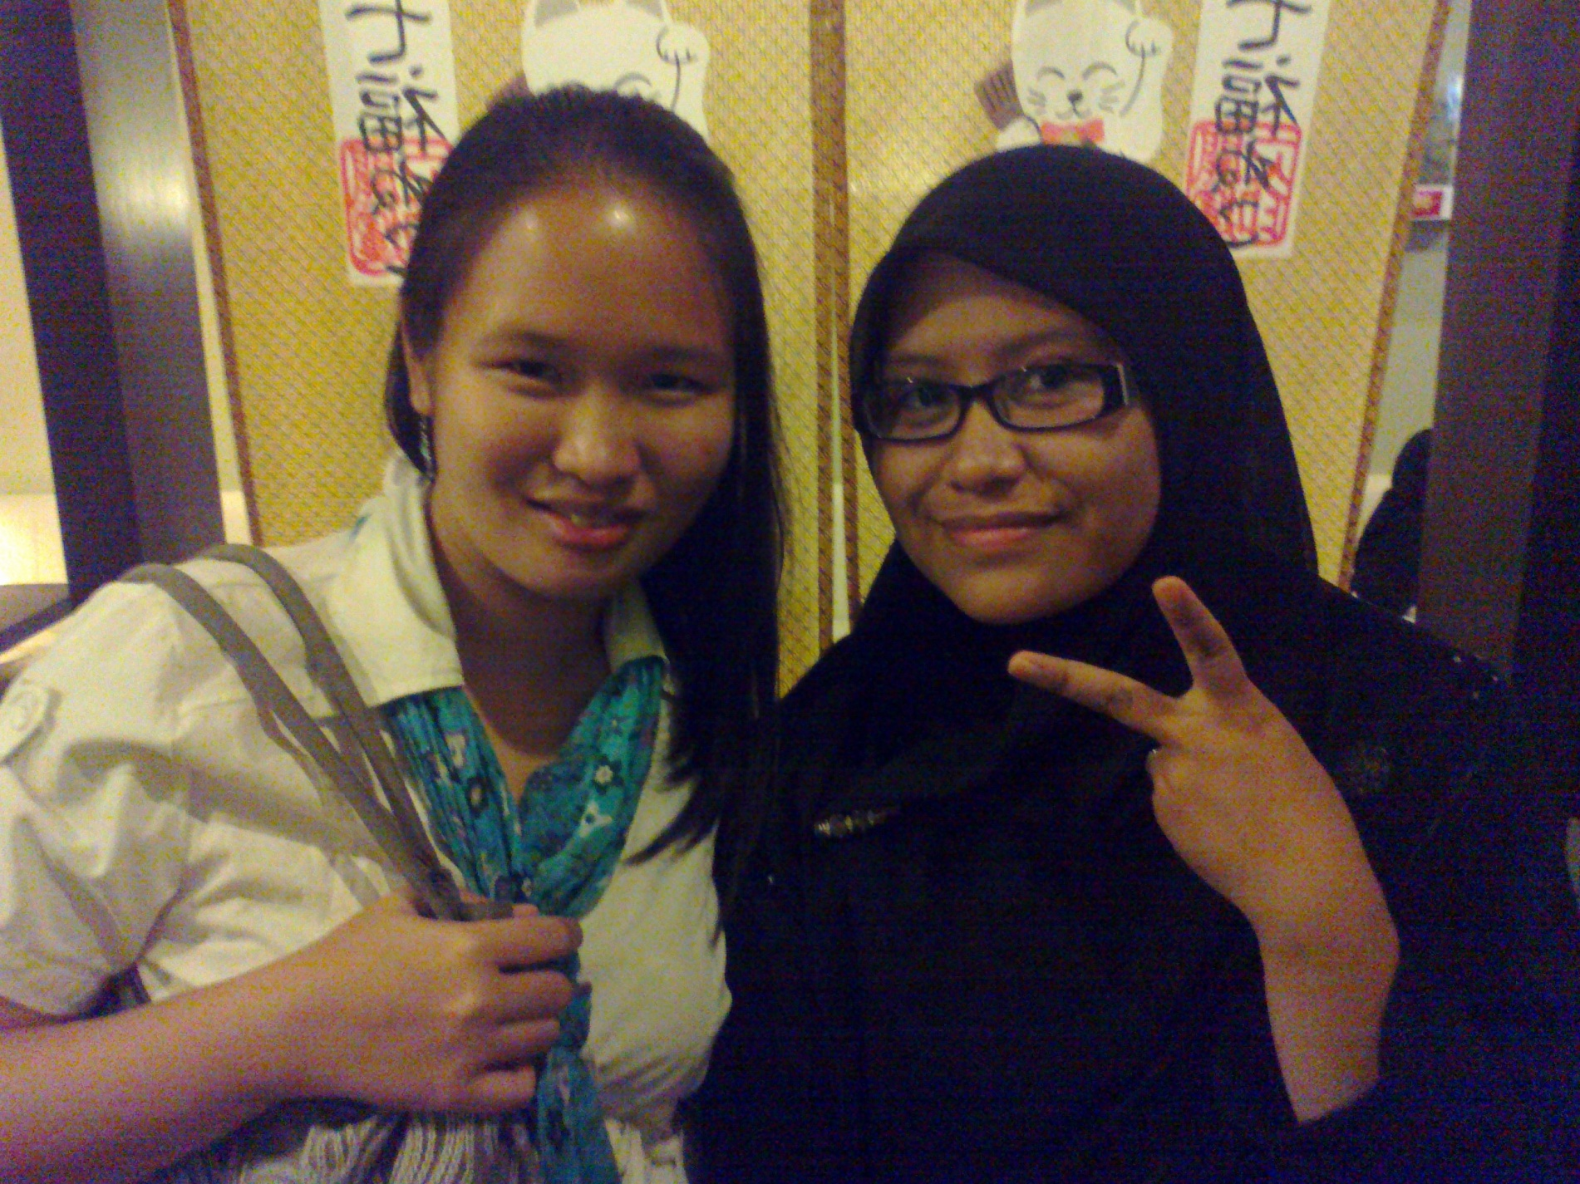
Notes:
YES CORNER IS LOCATED NEAR THE TUTTI FRUTTI.
WE WENT OUT AGAIN JUST TO TASTE THE JAPANESE CUISINE THAT PEOPLE WERE TALKING ABOUT.
WHEN WE WENT THERE WE CAN SEE A MULTIRACIAL PEOPLE ENJOY EATING SUSHI.
THAT WAS OUR LIFE IN IPGKDRI.

Slide 16
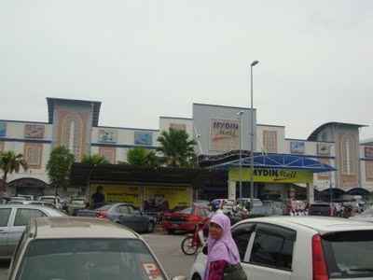
Notes:
NEXT IS MYDIN. YOU KNOW MYDIN RIGHT??
MYDIN IS THE PLACE WHERE WE CAN FIND EVERY SINGLE THINGS.
YOU CAN ALSO FIND LOVE THERE IF YOU WANT.
INTERESTING IS IT?
MYDIN IS THE LARGEST WHOLESALE HYPERMARKET IN EAST COAST OF MALAYSIA ESPECIALLY TERENGGANU.

Slide 17
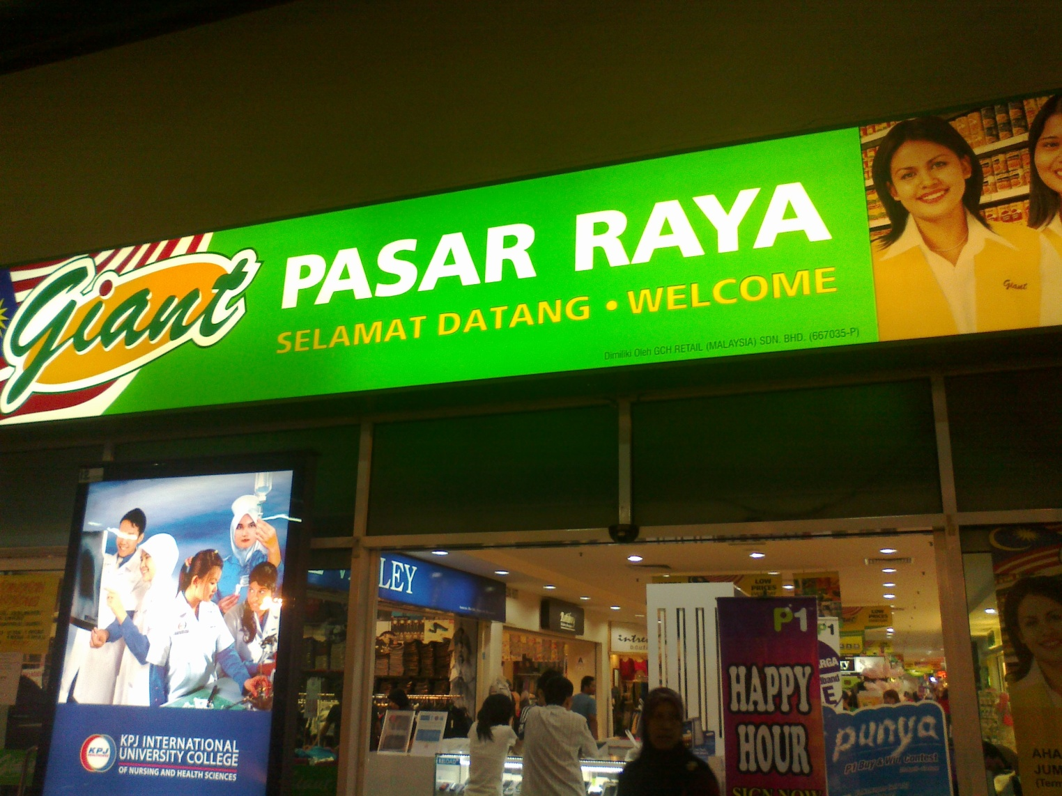
Notes:
INSTEAD OF MYDIN YOU CAN ALSO BUY YOUR THINGS AT GIANT.
IT IS SITUATED BESIDE MYDIN.
SOMETIMES WE CONFUSED WHERE TO GO EITHER GIANT OR MYDIN BECAUSE THESE TWO HYPERMARKET WAS SO FAMOUS.
BUT EVERY TIME WE WENT TO TOWN, WE PARKED OUR CAR AT GIANT BECAUSE MYDIN WAS USUALLY FULLY PARKED.
GIANT

Slide 18
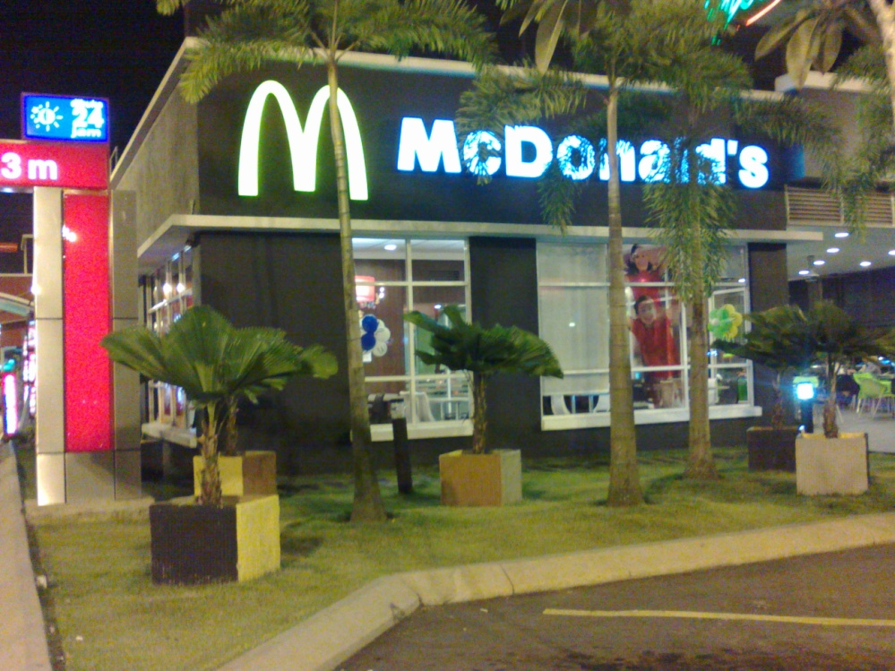
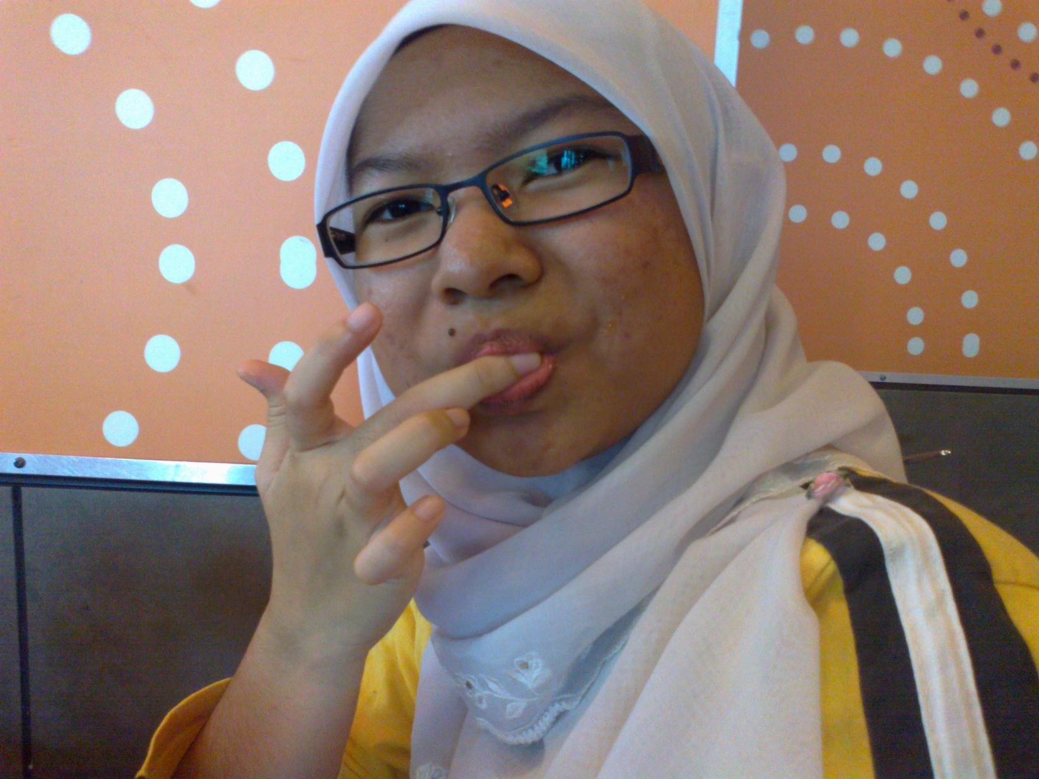
Notes:
I’M LOVIN’T IT. THIS IS MCDONALD RESTAURANT.
WE ALWAYS DRIVE THRU IF WE DID NOT HAVE MUCH TIME TO SETTLE DOWN THERE.
ONE THING ABOUT MC DONALDS IS THEY HAVE A VERY DELICIOUS BURGER.
THAT IS WHY WE LOVE MC DONALDS SO MUCH.

Slide 19
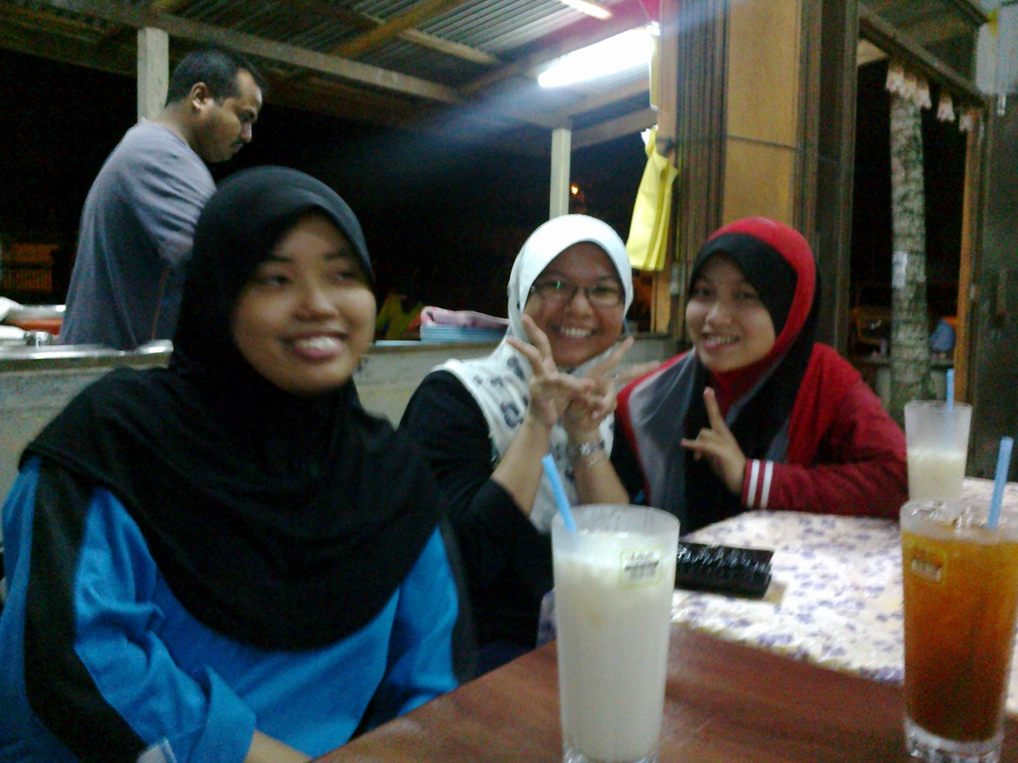
Notes:
DO YOU NOTICE THIS RESTAURANT?? THIS IS KEDAI PAYANG.
THIS IS OUR DAILY PLACE WHERE WE DO NOT HAVE ANY CHOICE TO HAVE A MEAL.
SOMETIMES, IF WE ARE LAZY, WE JUST ORDERED THE FOOD THROUGH MESSAGES AND ABOUT TWO OR THREE HOURS LATER, THE FOOD ARRIVED.
IT IS SUGGESTED FOR THOSE WHO DO NOT WANT TO GET FAR FROM IPGKDRI.

Slide 20
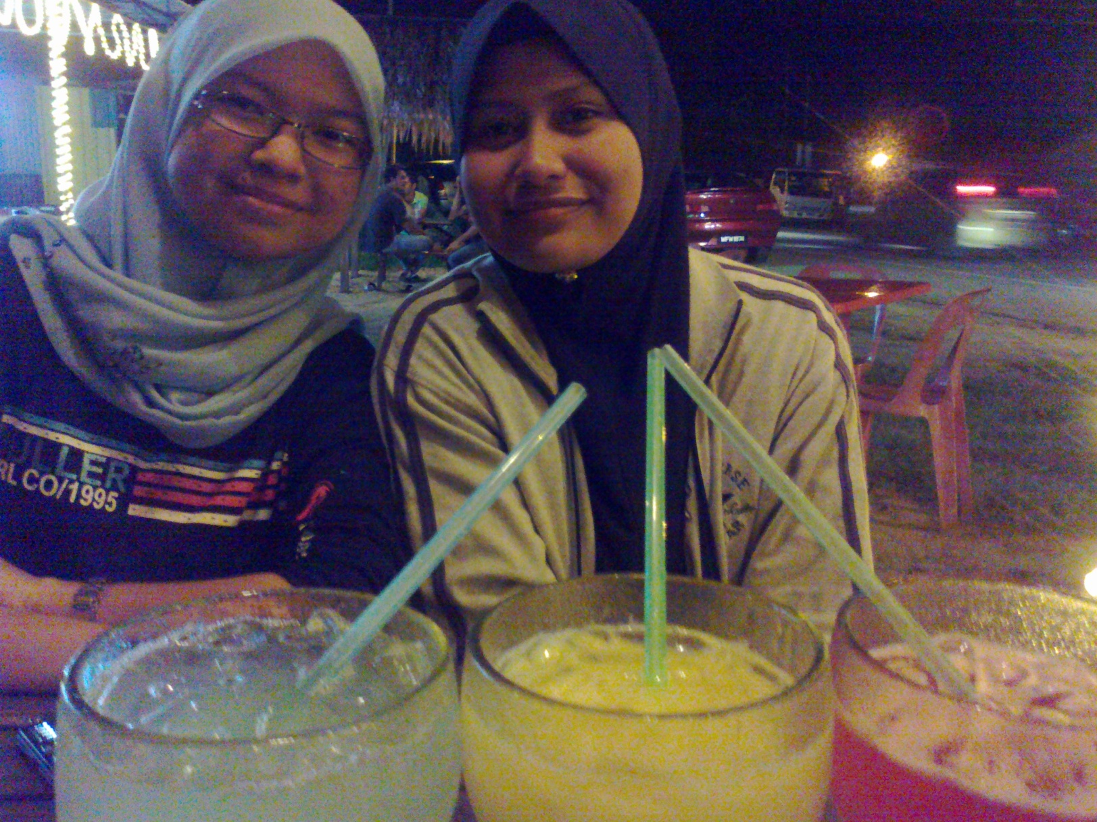
Notes:
IF WE FELT BORED TO DEATH EATING AT KEDAI PAYANG, WE STRAIGHT AWAY WENT TO BAKAWALI.
IT IS SITUATED NEAR THE TRAFFIC LIGHT IN FRONT OF OUR IPG.
WE USUALLY WENT THERE BY GROUP AND WALKED TO GET THERE.
BUT, WE PREFER KEDAI PAYANG MORE THAN BAKAWALI.

Slide 21
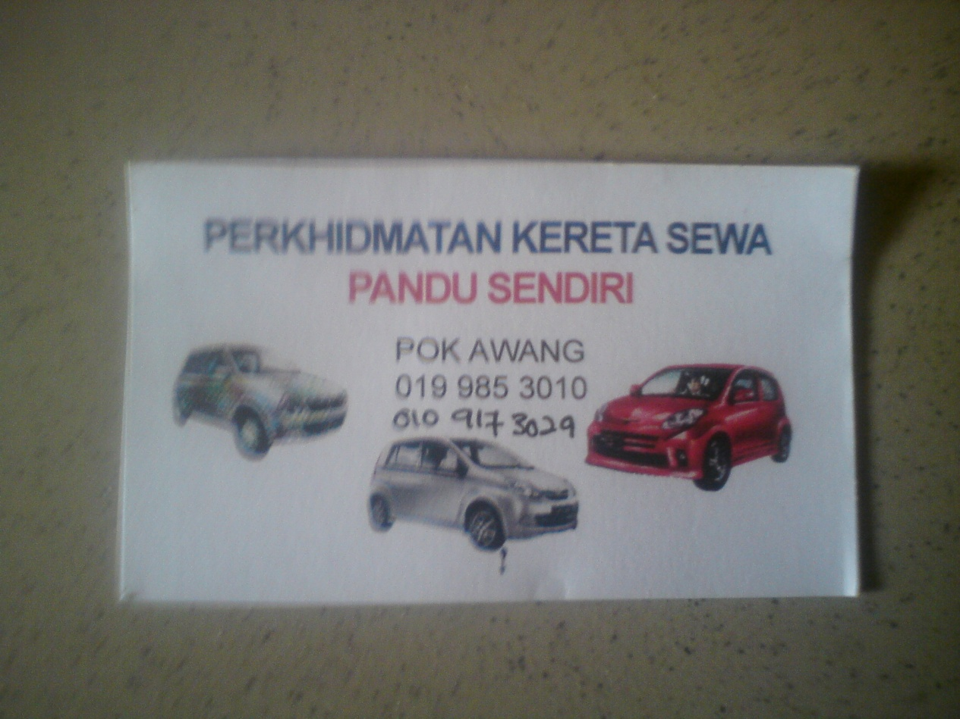
Notes:
WE HAVE BEEN TO MANY PLACES AND IT SHOWED THAT WE HAVE A SOCIAL LIFE IN IPGKDRI.
THE MAIN REASON THAT WE ALWAYS WENT OUT IS JUST TO SURVEY A NEW PLACE TO EAT AND SIGHTSEEING TO FILL OUR FREE TIME.
WE ALWAYS RENT A CAR FROM PAK AWANG AGENCY.
OVERALL, OUR SOCIAL LIFE IS MOSTLY ABOUT FOOD.
THANK YOU.

